Slide 1
Implier – Background
Ben Lackey

Slide 2
Definitions
Nearby
When several futures contracts are considered, the contract with the closest settlement date is called the nearby futures contract.
http://financial-dictionary.thefreedictionary.com/Nearby+futures+contract
Deferred
Among several different futures contracts, the one with the longest maturity. For example, given three futures contracts, one expiring in March, one in June, and one in September, the deferred futures is the one expiring in September.
http://financial-dictionary.thefreedictionary.com/Deferred+Futures

Slide 3
Trading the Spread
Buy the Spread, Bull Spread, Carry
Long the nearby month, short the deferred month
Sell the Spread, Bear Spread, Rollover
Short the nearby month, long the deferred month

Slide 4
Question
Do people buying the spread account for the bid value in a spread matrix for example the March/June bid?
Do people selling the spread account for the ask value in a spread matrix for example the March/June ask?

Slide 5
Question
Are the bids and asks for the spreads all implied INs or do markets support trading the spread natively?
For example, if I want to buy the March/June spread:
1. Must I buy a March contract and sell a June contract
2. Or is it possible to buy a single instrument that represents the March/June spread?
It looks like the answer is 2 for CME – see RT in this:
http://www.cmegroup.com/globex/files/SDKcomexFutures.pdf

Slide 6
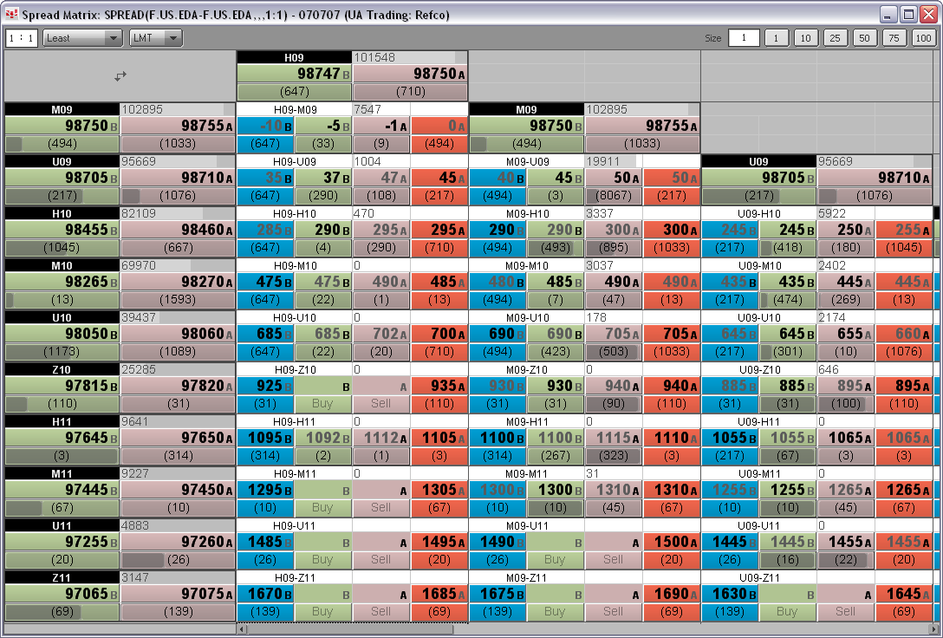
Spread Matrix in CQG

Slide 7
Spread Matrix with No Implied Volume
March
Bid
150x95.50
Ask
March/June
June
Bid
Ask
050x00.10
Bid
100x95.40
Ask
March/September
June/September
September
Bid
Ask
Bid
Ask
Bid
100x95.25
Ask

Slide 8
Spread Matrix with Implied Volume
March
Bid in Nearby – Ask in spread = Implied OUT bid in deferred
Bid
150x95.50
Ask
March/June
June
Bid
Ask
050x00.10
Bid
100x95.40
050x95.40
Ask
March/September
June/September
September
Bid
Ask
Bid
Ask
Bid
100x95.25
Ask

Slide 9
ICE
1st Generation implied volume supported
https://icelive.theice.com/ice_files/ICELivePro_enhancements.pdf

Slide 10
LIFFE - EURIBOR
1st Generation implied volume supported
http://www.nyse.com/pdfs/6471_LRS.pdf
The ArcaBook market data feed for NYSE Liffe also disseminates ‘Implied Out’ prices. Indeed, the LIFFE CONNECT platform supports both Implied Ins and Implied Outs prices.
‘ Implied Ins’ are prices in a strategy market derived from prices in the associated outright markets. They are calculated by the Trading Host but not disseminated.
‘ Implied Outs’ are prices in an outright market derived from prices in one strategy and prices in associated legs of the strategy. Although the LIFFE CONNECT. Trading Host continuously calculates ‘implied out’ prices, it only transmits ‘implied out’ prices when they are equal to or better than the Best price in the central Order Book.

Slide 11
CME
1st and 2nd Generation implied volume supported
http://www.cmegroup.com/globex/files/ImpliedPriceOverview.pdf

Slide 12
CME – Implied In
1. There is a Bid in SIZ6 at 13955.
2. There is an Ask in SIG7 at 14025.
3. This creates an Implied IN Bid in the Silver calendar spread SIZ6-SIG7 at -70.
Implied IN Bid in nearby/deferred spread = Bid in nearby – Ask in deferred

Slide 13
CME – Implied Out Bid
1. There is a Bid in SIZ6 at 13955.
2. There is an Ask in the Silver calendar spread of SIZ6-SIG7 at -74.
3. This creates an Implied OUT Bid in SIG7 at 14029.
4. All implied OUT bids are rounded down to the next standard tick.
5. Implied OUT Bid is created in SIG7 at 14025.
Implied OUT bid in deferred = Bid in nearby – Ask in spread of nearby/deferred

Slide 14
CME – Implied Out Ask
1. There is an Ask in SIZ6 at 13955.
2. There is a Bid in the Silver calendar spread of SIZ6-SIG7 at -74.
3. This calculates an Implied OUT Ask in SIG7 at 14029.
4. All implied OUT asks are rounded up to the next standard tick.
5. Implied OUT Bid is created in SIG7 at 14030.
Implied OUT ask in deferred = ask in nearby – bid in spread nearby/deferred

Slide 15
CME – 2nd Generation Implied
1. There is an Implied OUT Bid in the SIZ6 at 14010.
2. There is a real order for a 2-lot Ask in the SIF7 at 13995.
3. This creates an Implied 2nd Gen IN Bid order in the SIZ6-SIF7 at 15.
2nd generation implied IN bid in spread = implied bid in nearby – ask in deferred

Slide 16
Generalizing
Implied Bid in spread = Bid in nearby – Ask in deferred
Implied Ask in spread = Ask in nearby – Bid in deferred
Implied Bid in deferred = Bid in nearby – Ask in spread
Implied Ask in deferred = Ask in nearby – Bid in spread

Slide 17
Question
Are there ever implied OUTs in the nearby?
E.g.
Implied Bid in nearby = Bid in deferred + Bid in spread
Implied Ask in nearby = Ask in deferred + ask in spread
See next slide for an example

Slide 18
Question – Is this correctly implied?
March
Bid
150x95.50
Ask
Bid in Deferred + Bid in spread = Implied OUT bid in nearby
March/June
June
Bid
Ask
Bid
100x95.40
050x95.40
Ask
March/September
June/September
September
Bid
Ask
Bid
050x00.15
Ask
Bid
100x95.25
Ask

Slide 19
Question
Would an example of a 3rd generation implied be:
Implied^3 bid in spread = implied bid in nearby –implied^2 ask in deferred
Implied^3 bid in spread = implied^2 bid in nearby – implied^2 ask in deferred
Are both the above examples termed 3rd generation?

Slide 20
Possibly Related?
http://www.google.com/patents?vid=USPAT7039610

Slide 21
Exchange Connectivity – ICE
FIX 4.2
https://www.theice.com/connectivity.jhtml
https://www.theice.com/api.jhtml
Colocation available in Chicago
Chicago CoLo
$4000 installation
$3500/month

Slide 22
Exchange Connectivity – CME
FIX 5.0 - FIX/FAST
http://www.fixprotocol.org/fast
http://www.fixprotocol.org/products/detail/5474
http://www.cmegroup.com/globex/files/connectivityoptions.pdf
Colocation available in Chicago
CME DIRECTLink

Slide 23
Exchange Connectivity – LIFFE
Proprietary C++ API
http://www.euronext.com/fic/000/010/645/106455.pdf
http://www.euronext.com/fic/000/010/619/106194.pdf
Colocation available in London?
Direct access to LIFFE CONNECT™ is available to an exchange member or to an affiliate of an existing member.

